Slide 1
Mid Point Review FYP
(Self-Driving Neural Network to handle multiple off-road terrains)
By David Taylor

Slide 2
What is my Final Year Project?

Slide 3
My Final Year Project
The Project:
Self-Driving Neural Network to handle multiple off-road terrains
Why?:
AI cars in games feel rigid and where AI cars can get easily confused and stuck
How?:
To make this large undertaking easier I am using three main elements, Unreal Engine 4, TensorFlow and a Plugin that allows TensorFlow to be run in UE4.
What is the Final Software goal?:
Unassisted movement
Safely traversing over altering terrain (Ice/Steep inclines/Steep Desents/Uneven Terrain)
Movement to a predetermined location

Slide 4

My Plan To Achieve my goal

Slide 5
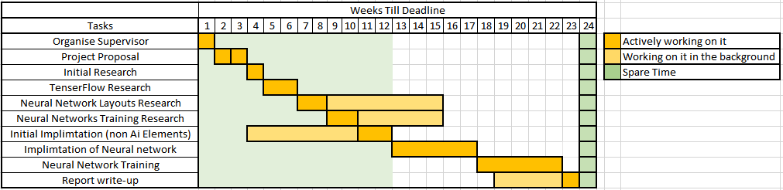
Project Plan
We are currently at the end of the 13th Week
I have left the 24th week free just if any large issue arises towards the end of the project.
Total time left (including out of university time) is 16 Weeks and 4 Days

Slide 6
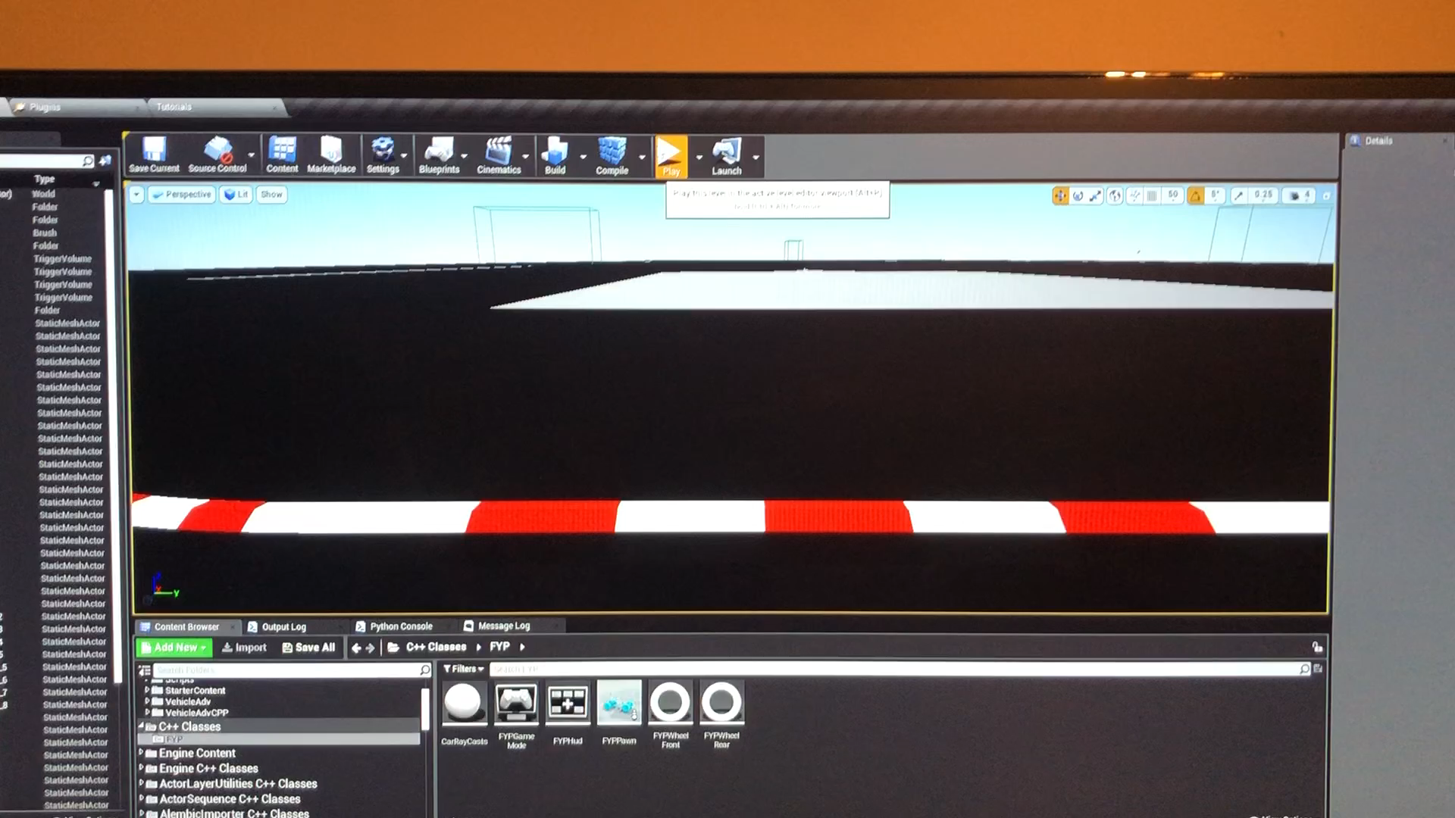
Current Progress
All necessary software installations
Alteration of the base UE4 advance car template
Communication between the two elements (UE4 C++ & Blueprints and Python TensorFlow)
Control of the car from Python and TensorFlow elements
Notes:
As shown in the time scale above I have completed all groundwork needed with the project. This includes:
Installation of Cuda, Cudnn, TensorFlow, Python, UE4 and “Getnamo’s” TensorFlow for UE4 plugin.
An Augmented Advance Car Template Project to have the car read in necessary information.
Communication Between UE4 C++ & Blueprints (Car and Sensors) and UE4 Python & TensorFlow (AI Brain).
Control Of the car from the TensorFlow Functions. (Currently Hard Coded to always go forward and right) .

Slide 7
Project Organisation

Slide 8
Time Management
I have organized my time into weekly blocks to allow me to work on all university modules weekly.
This is personally more productive allowing me to keep ahead/on par with my project plan.
In addition I spend half a day a week researching any useful information and reviewing my knowledge of neural networks.
During my weekly blocks the structure is to fix any bugs first, then the more complex tasks and finally the elements that require the most time commitment to complete.
During the weekly blocks, I use a Trello board to track my progress and what tasks need to be done.

Slide 9

Any Questions?

